Slide 1
ChemE 485: Process Design I
Lecture 7: Notes from Aspen Demo
Prof. Chad Curtis
Jan. 24, 2020

Slide 2
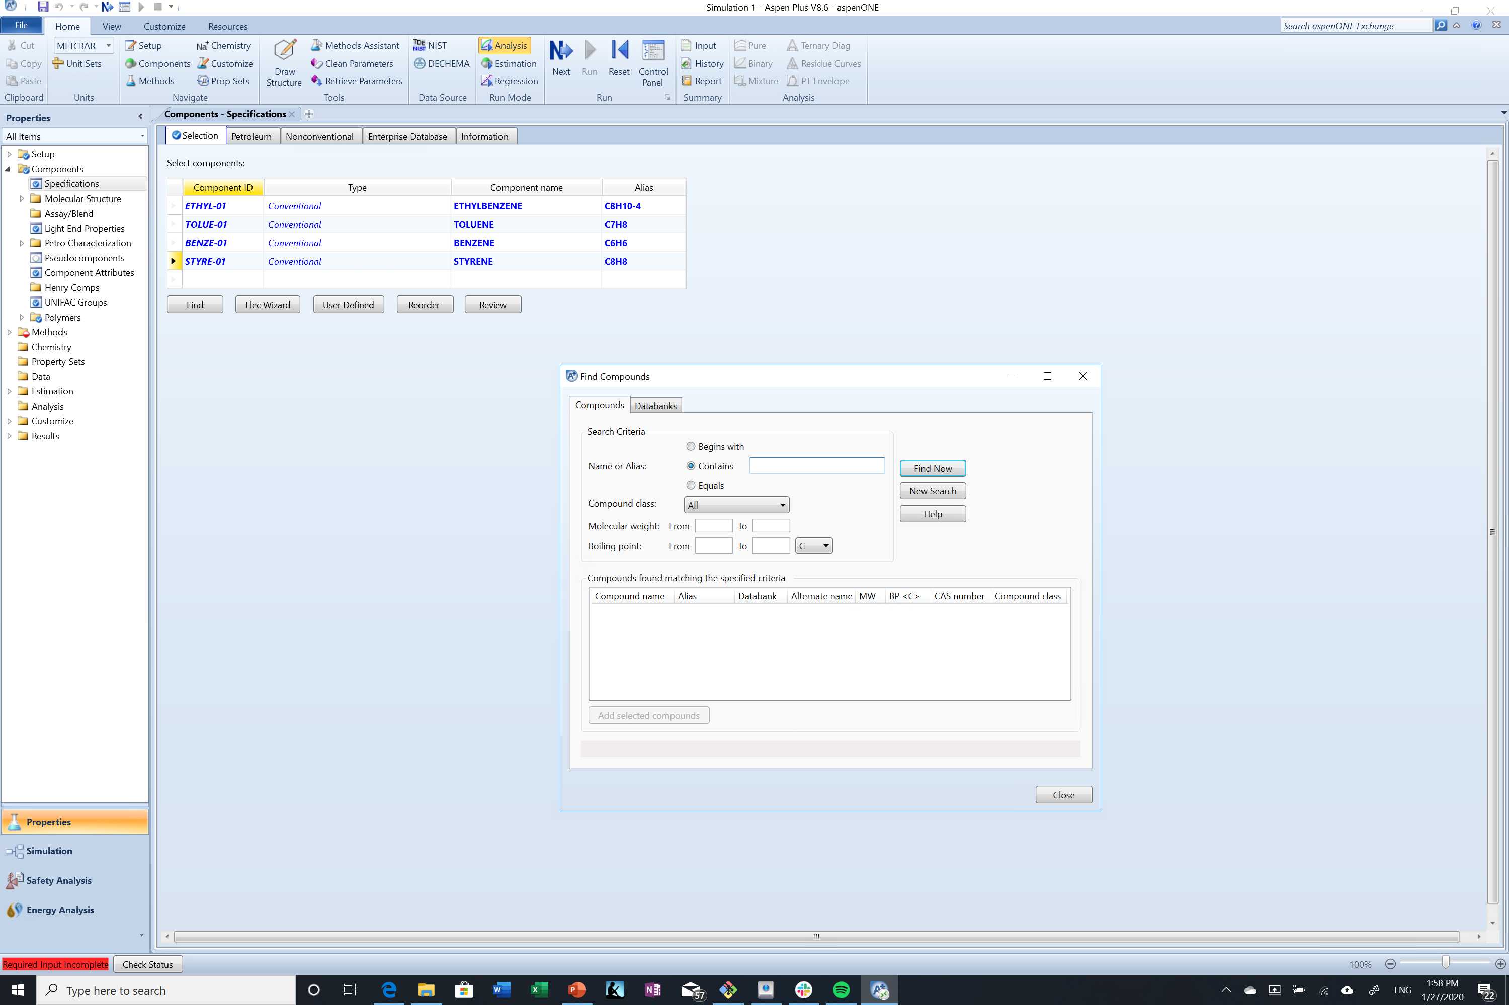
Step 1: Add components
Step 1: Add compounds to components sheet

Slide 3
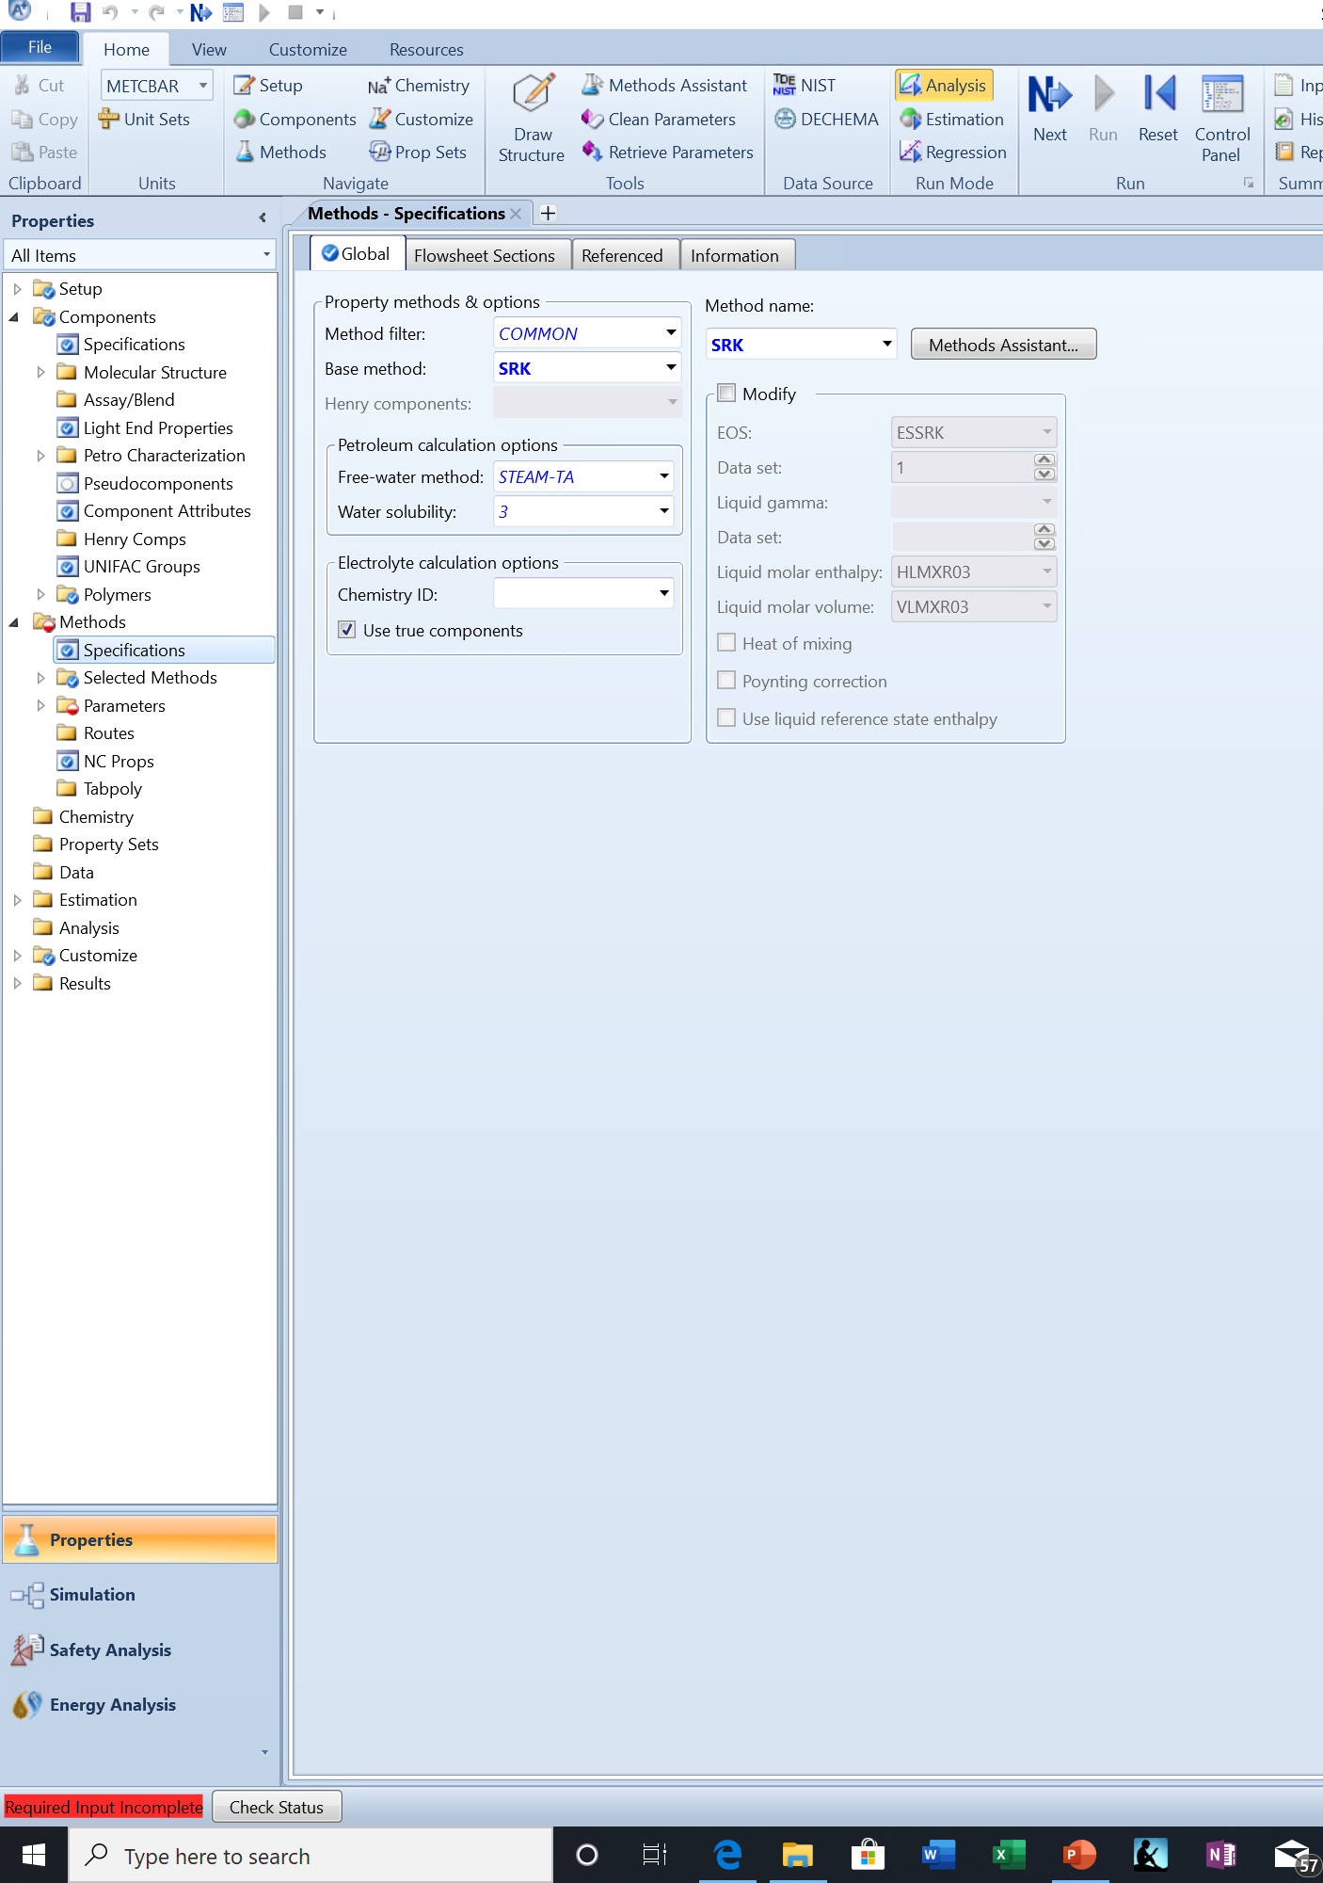
Step 2: Select thermo package
Since this system, is all hydrocarbons, you can stick with SRK or Peng-Robinson.
You can verify this selction using the Methods Assistant, but don’t blindly use this.
Sometimes the water method will need to be changed based on the thermo package you select. Don’t worry about it unless you get an error message.

Slide 4
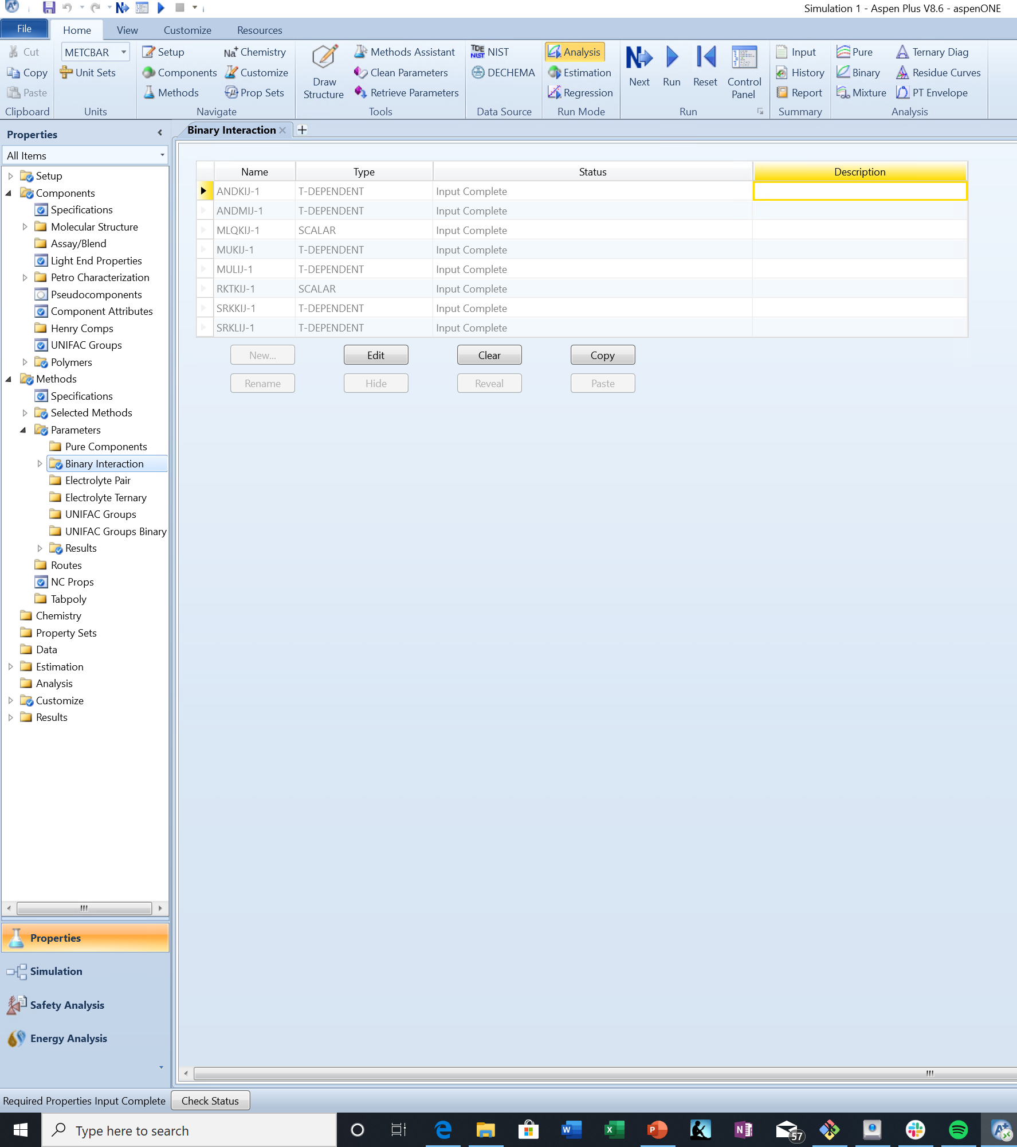
Step 2: Select thermo package
The system forces you to verify that all binary interaction parameters are correct, even if they are automatically pulled from a database.
Red error message in bottom left-hand corner will go away once a thermo package is selected. All relevant inputs are ready to go.

Slide 5
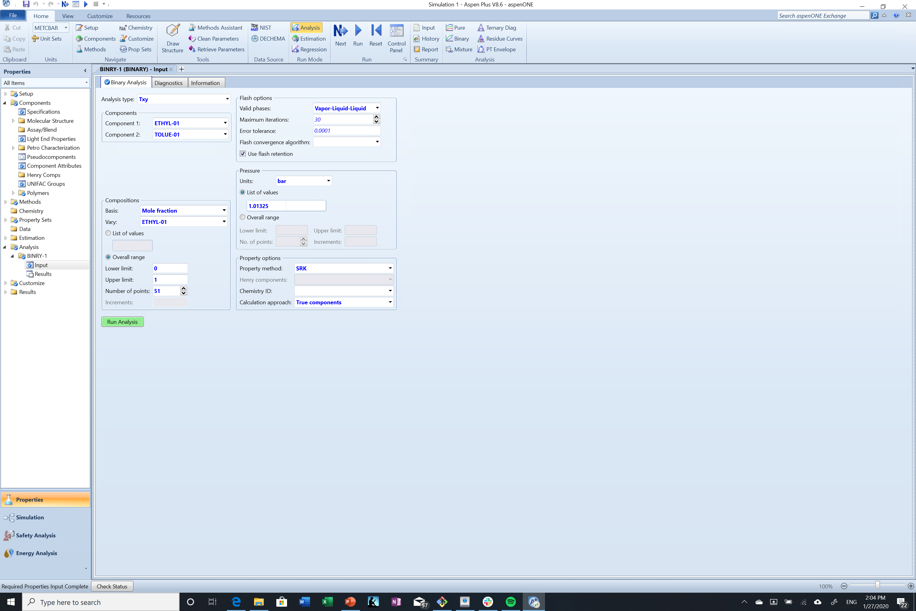
Checking for azeotropes
The binary tab will let you create Txy and xy diagrams. Hit “run analysis” to generate the plot.

Slide 6
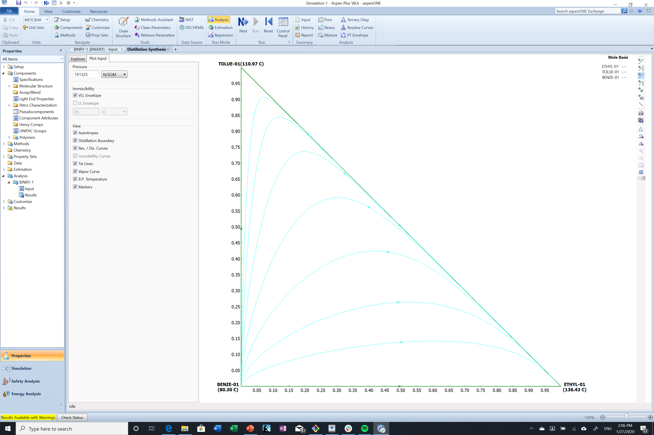
Checking for azeotropes
Ternary diagrams can be used to check the dynamics of three-component systems. Info on interpretation in C12 of your book. Curves represent concentrations of liquid residue in batch distillation.

Slide 7
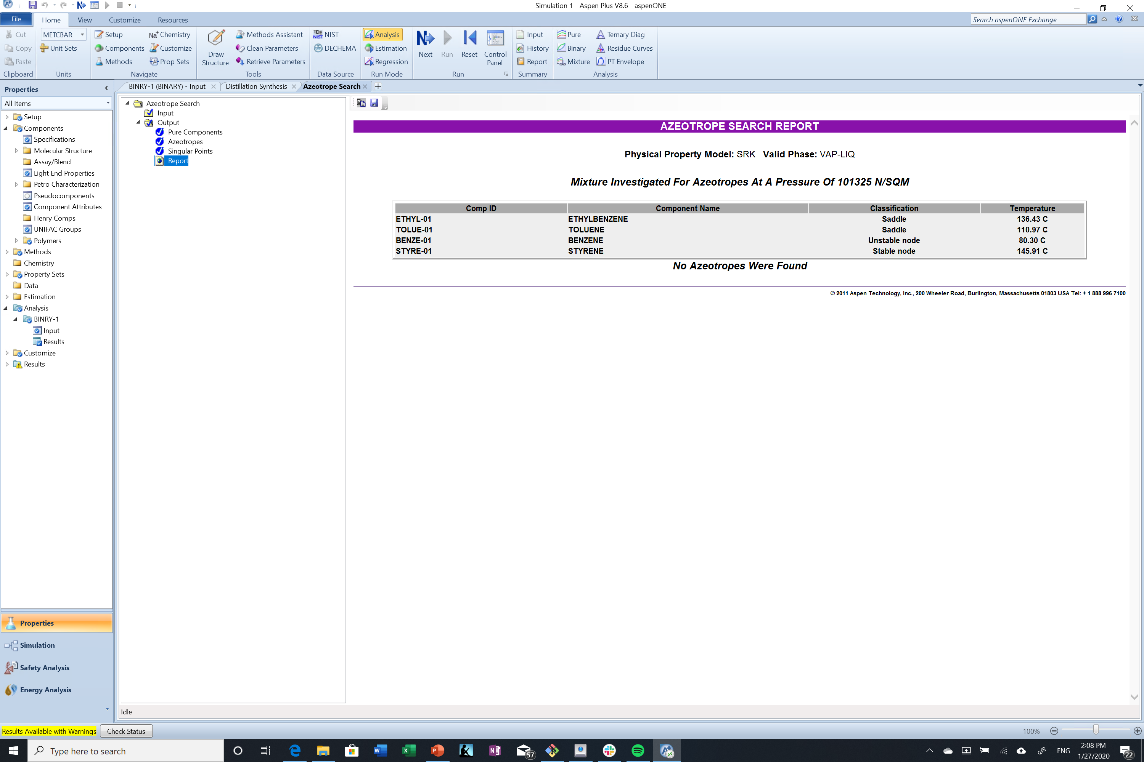
Checking for azeotropes
The “Find Azeotropes” button is hidden– you have to hit the “Ternary Diag” button to find. It will auto-find azeotropes and list their boiling points for you. Very good for systems with many components. Good to check every time.

Slide 8
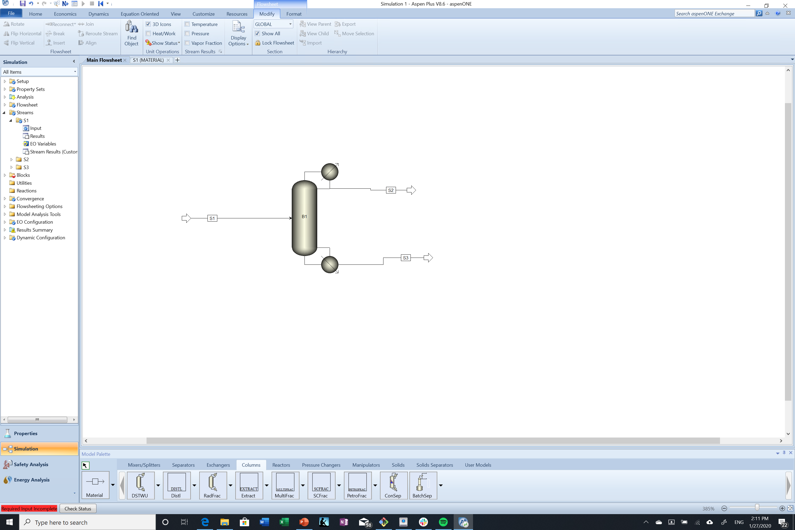
L1 Simulation: DSTWU
L1 simulation for a distillation column uses the shortcut DSTWU method. Only requires the desired recoveries of the light and heavy keys in the distillate, the reflux ratio, and pressures in the reboiler/condenser

Slide 9
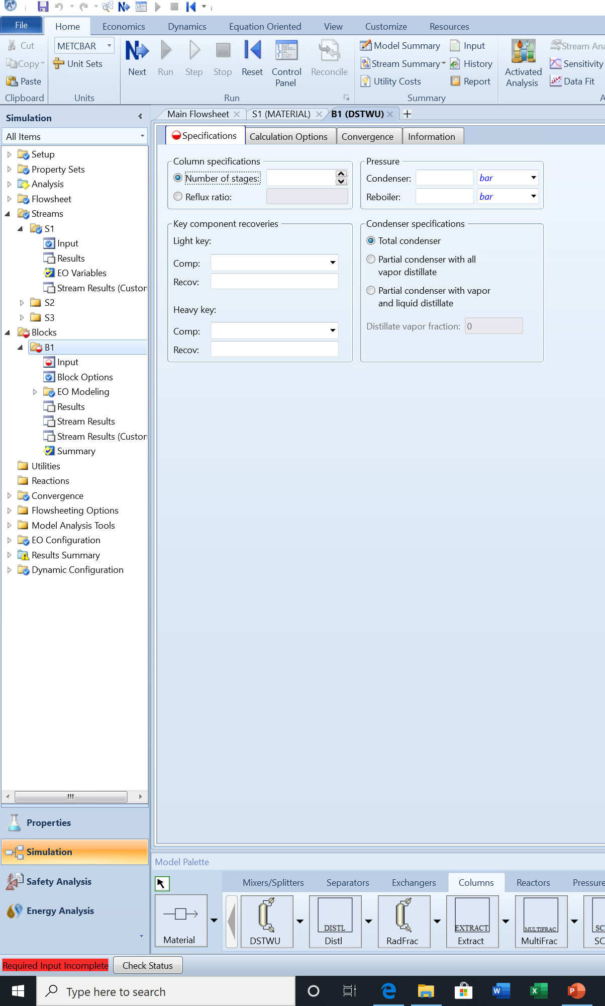
L1 Simulation: DSTWU
For first guess, enter the reflux ratio as a multiple of the minimum reflux ratio (put in a as a negative number to do this).
Remember that the light key recovery is the ratio of light key in the distillate and the heavy key recovery is the ratio of the heavy key in the distillate. The light key recovery should be close to 1, and the heavy key recovery should be close to 0.
You need a pressure difference between the condenser and reboiler to drive vapor flow through the column.

Slide 10
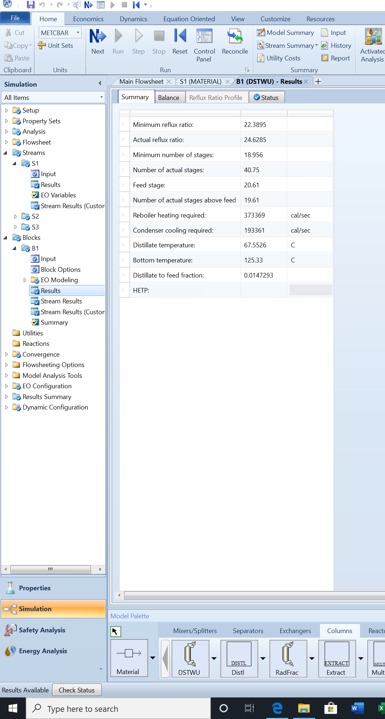
L1 Simulation: DSTWU
Check both the Results and Stream Results tabs to make sure your results are as anticipated.
You can use the results from your L1 simulation as inputs to your L2 simulation.

Slide 11
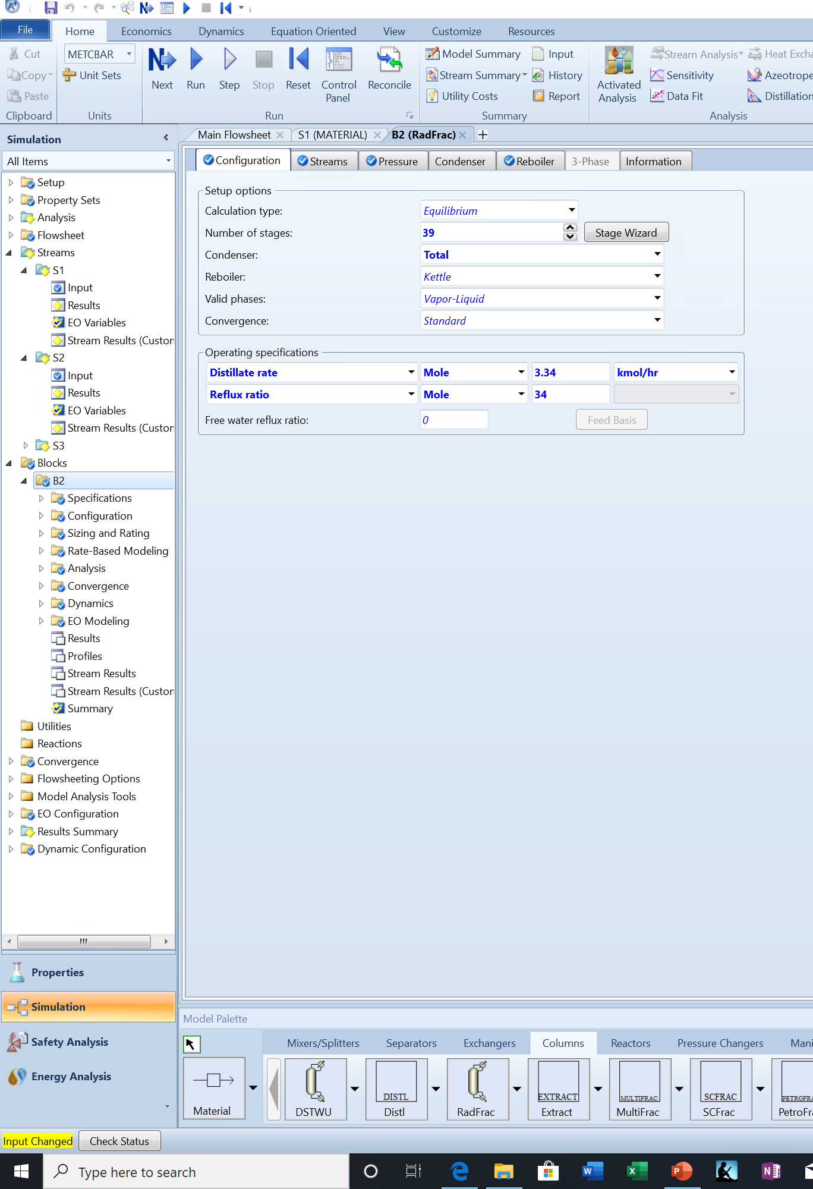
L2 Simulation: RadFrac
Use the reflux ratio and number of stages data from L1 simulation to do L2 simulation. May need to adjust if the distillation column doesn’t have 100% efficiency.
Also need to fill in stream and pressure tabs to complete inputs.

